Slide 1

Coursera Capstone project Coursera
IBM Data Science Certification
Arif Zainurrohman
Nov 2nd, 2020

Slide 2
Report Content
Introduction Section : The “business problem” to be solved by this project and who may be interested
Data Section: Describe Data requirements and Sources needed to solve the problem
Methodology section: Main component of the report - Execute data processing, describe/discuss any exploratory data analysis and/or inferential statistical testing performed, and/or machine learnings used.
Results section: Discussion of the results and finding of answer
Discussion section: Discussion of observations noted and any recommendations
Conclusion section: Answer chosen and conclusions.

Slide 3
1.0 Introduction
1.1 Scenario and Background
I am a business analyst currently residing in Jakarta Barat Indonesia. I currently live within walking distance to buy food therefore I have access to good public transportation to geet it. Likewise, I enjoy many ammenities in the neighborhood , such as international cousine restaurants, cafes, food shops and entertainment. I have been offered a great opportunity to work in Jakarta. Although, I am very excited about it, I am a bit stress toward the process to secure a comparable place to live in here.
1.2 Problem to be resolved
The major purpose of this project, is to suggest a better neighborhood in a new city for the person who are shiffting there. Social presence in society in terms of like minded people. Connectivity to the airport, bus stand, city center, markets and other daily needs things nearby.
Show list of venue in Jakarta Barat
Show list of Hospital in Jakarta Barat
1.3 Interested Audience
I believe the methodology, tools and strategy used in this project is relevant for a person or entity considering moving to a major city in Indonesia. Likewise, it can be helpful approach to explore the opening of a new business. The use of FourSquare data and mapping techniques combined with data analysis will help resolve the key questions. Lastly, this project is a good practical case for a person developing Data Science skills.

Slide 4
2.0 Data Section
2.1 Data Requirements
Geodata for current residence in Jakarta Barat, Indonesia with venues established using Foursquare.
List of Jakarta Barat postcode
https://www.indonesiapostcode.com/location/jakarta/jakarta-barat/
List of Hospital in Jakarta
https://raw.githubusercontent.com/cahyati/Coursera_Capstone/master/Hospital%20for%20treatment%20covid-19.csv
2.2 Data Sources, Data Processing and Tools used
Jakarta Barat data and map is to be created with use of Nominatim , Foursquare and Folium mapping
Jakarta Barat Postcode were obtained from Indonesia postcode and organized by Neighborhoods with geodata via Nominatim for mapping with Folium.
List of Subway stations was obtained via Wikipedia, NY Transit web site and Google map,
List of hospital for rent was consolidated from web-scraping. The geolocation (lat,long) data was found with algorithm coding and using Nominatim.
Folium map was the basis of mapping with various features to consolidate all data in ONE map where one can visualize all details needed.

Slide 5
3.0 Methodology
The Strategy to find the answer:
The strategy is based on mapping the described data in section 2.0. The information will be consolidated in ONE MAP where one can see the details of the venue
The Tools:
Web-scraping of sites is used to consolidate data-frame information which was saved as csv files for convenience and to simply the report. Geodata was obtained by coding a program to use Nominatim to get latitude and longitude of Kecamatan and also for each venue listed. Geopy_distance and Nominatim were used to establish relative distances.

Slide 6
4.0 Execution and Results

Slide 7
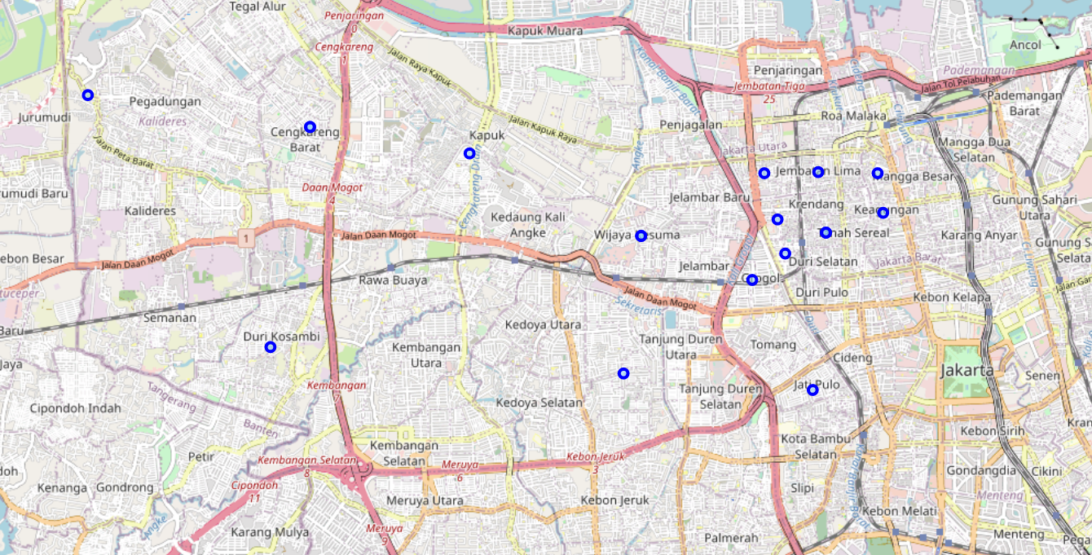
Current Kecamatan Neighborhood in Jakarta Barat

Slide 8
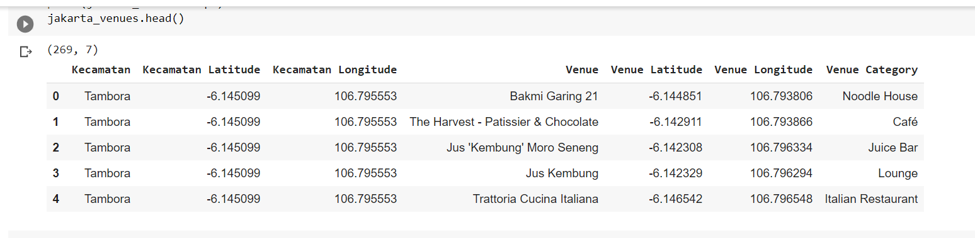
Venues around Kecamatan in

Slide 9
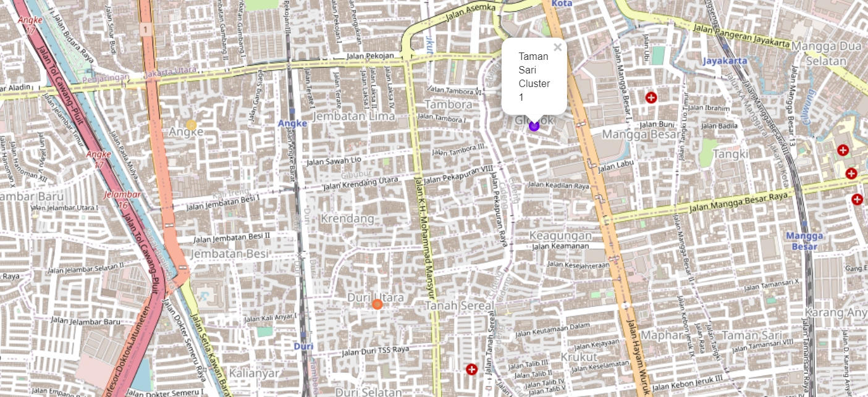
Jakarta Barat Map - Kecamatan and Cluster of Venues

Slide 10
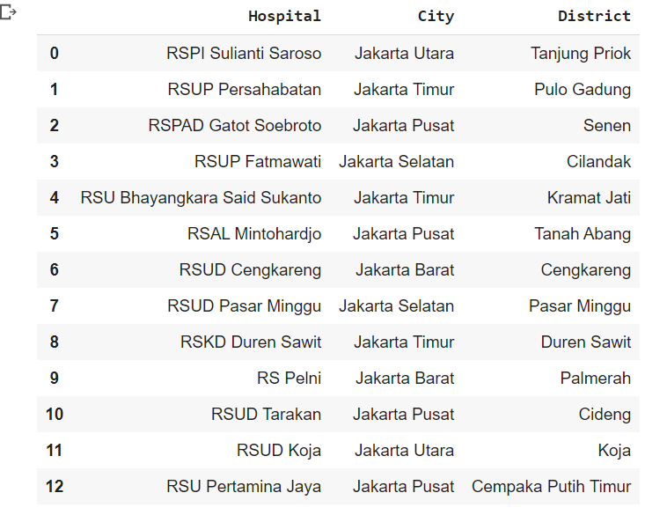
Hospital in Jakarta

Slide 11
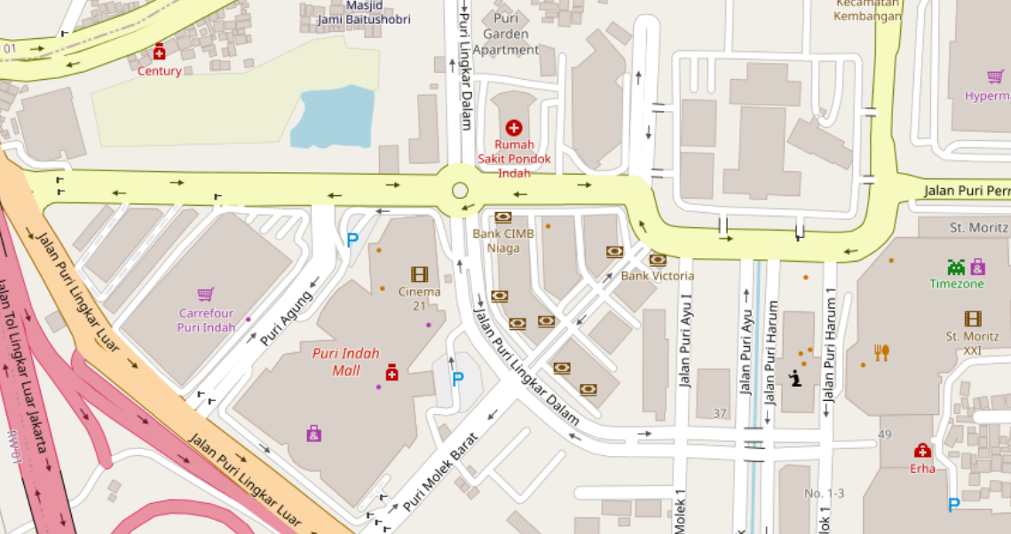
Map of Hospital in Jakarta

